Slide 1
Machine learning 101 Tips on Neural networks(2)
Han Xiao
hxiao29@wisc.edu
CEE department
Most slides from Hung-yi Lee

Slide 2
Objective
Understand basic strategy to optimize neural networks
Understand why neural networks should be ‘deep’

Slide 3



Neural networks
feedforward + Backpropagation
Input
Layer 1
Layer 2
Layer L
……
$${\hat{y}}_{1}$$
……
$${\hat{y}}_{2}$$
……
……
……
……
……
……
$${\hat{y}}_{n}$$
Input Layer
Output Layer
Error E
MSE, cross-entropy…
Hidden Layers

Slide 4
Neural networks
How to build neural networks?
Step 1: decide the structure of your network (depth, the number of neurons in each layer…)
Step 2: decide your activation function
Step 3: initialize your w and b
Step 4: Train!
- Forward propagation
- Backpropagation
Step 5: Generalization

Slide 5

Overfitting
Too powerful!
Where could we get errors?
$$y=x$$

Slide 6
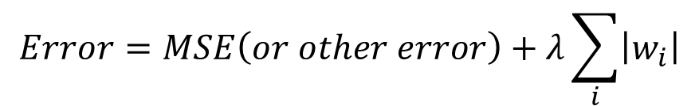
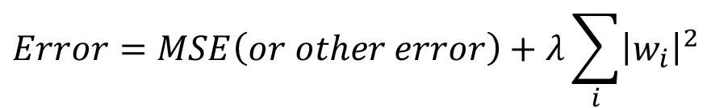
Regularizers
$$Error=MSE\left(or other error\right)+regularizer$$
L1 regularizer
L2 regularizer
$$Error=MSE\left(or other error\right)+λ\sum_{i}{\left|w_{i}\right|}$$
$$Error=MSE\left(or other error\right)+λ\sum_{i}{{\left|w_{i}\right|}^{2}}$$

Slide 7
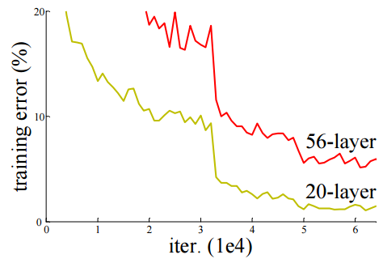
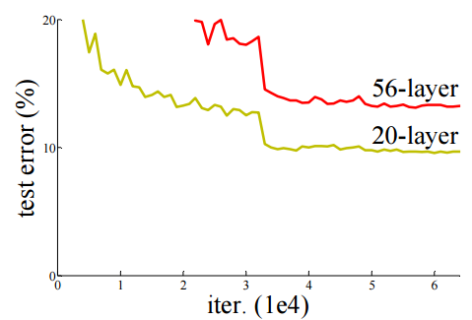
Overfitting
Badly trained
Train data
Test data

Slide 8
Optimizing strategy
Activation function
Train error
Learning rate
Regularizer
Early stopping
Test error
Overfitting
Dropout

Slide 9
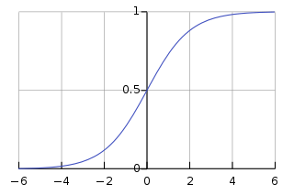
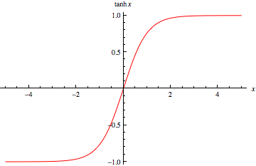
Activation function
Why activation function matters?
Your output depends on that!
Sigmoid function
Tanh function

Slide 10
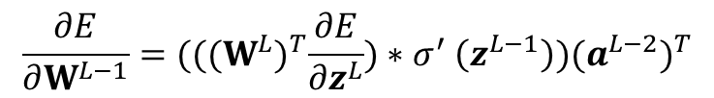
Activation function
Gradient vanishing + gradient exploding
vanish
$$\frac{∂E}{∂W^{L−1}}={(((W^{L})}^{T}\frac{∂E}{∂z^{L}}){∗σ}^{′}\left(z^{L−1}\right){)(a^{L−2})}^{T}$$
explode
From next layer
Back propagation
From previous layer
Feed forward
vanish
Sigmoid function

Slide 11





Activation function
ReLU (Rectified Linear unit)
$$a$$
Advantage:
Nonlinear
Gradient vanishing problem
Works like DROPOUT
$$σ\left(z\right)$$
$$a=z$$
$$a=0$$
$$z$$

Slide 12

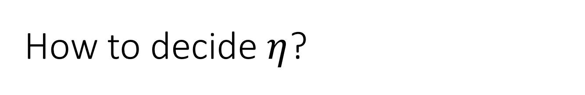

How to decide $η$?
Make it large first, then reduce it gradually depends on the number of iteration
Adam, RMSprop…
$$η_{t}=\frac{η}{1+t}$$
$$η_{t}=\frac{η}{\sqrt{1+t}}$$

Slide 13


Learning rate
Learning rate change with iterations
Momentum
$$η_{t}=\frac{η}{1+t}$$
$$η_{t}=\frac{η}{\sqrt{1+t}}$$

Slide 14



Learning rate
Total
Loss
Very slow at the plateau
Stuck at saddle point
Stuck at local minima
$$∂L∕∂w$$
$$≈0$$
$$∂L∕∂w$$
$$=0$$
$$∂L∕∂w$$
$$=0$$
The value of a network parameter w

Slide 15
In physical world ……
Momentum
How about put this phenomenon in gradient descent?
Notes:
Momentum: 動量

Slide 16
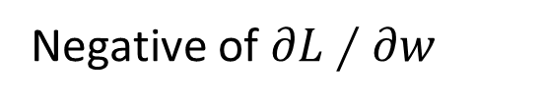
Momentum
cost
Movement =
Negative of 𝜕𝐿∕𝜕𝑤 + Momentum
Negative of $∂L∕∂w$
Momentum
Real Movement
𝜕𝐿∕𝜕𝑤 = 0
Notes:
What can we see?

Slide 17
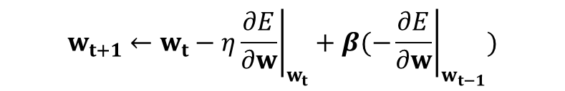
Momentum
Still not guarantee reaching global minima, but give some hope ……
$$w_{t+1}←w_{t}−η{\left.\frac{∂E}{∂w}\right|}_{w_{t}}+β(−{\left.\frac{∂E}{∂w}\right|}_{w_{t−1}})$$

Slide 18
Optimizing strategy
Activation function
Train error
Learning rate
Regularizer
Early stopping
Test error
Dropout

Slide 19
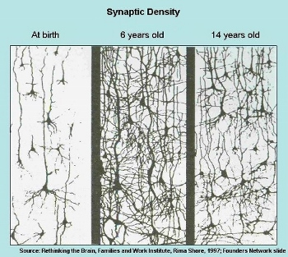
Dropout
Biological intuition

Slide 20
Dropout
Training:
Each time before updating the parameters
Each neuron has p% to dropout
Notes:
Iteration v.s. epoch!!!!!!!!

Slide 21
Dropout
Training:
Thinner!
Each time before updating the parameters
Each neuron has p% to dropout
The structure of the network is changed.
Using the new network for training
For each mini-batch, we resample the dropout neurons
Notes:
Do not worry that someone will not update

Slide 22
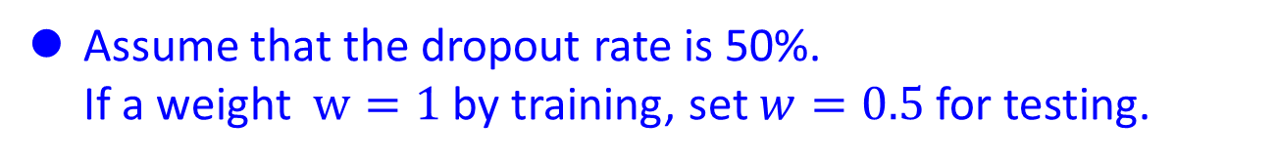
Dropout
Testing:
No dropout
If the dropout rate at training is p%, all the weights times 1-p%
Assume that the dropout rate is 50%.
If a weight $w=1$ by training, set $w=0.5$ for testing.
Notes:
Bias do not have to multiply !!!!!!!!!!!!!!!!!!!!!!!!!!!!!!!!!!!
Reasonable !!!!!!!!!!!!!!!!!!!!

Slide 23
Dropout - Intuitive Reason
When teams up, if everyone expect the partner will do the work, nothing will be done finally.
However, if you know your partner will dropout, you will do better.
When testing, no one dropout actually, so obtaining good results eventually.
Notes:
Why the weights should multiply p (dropout rate) at testing?

Slide 24
















Dropout - Intuitive Reason
Why the weights should multiply (1-p)% (dropout rate) when testing?
Training of Dropout
Testing of Dropout
Assume dropout rate is 50%
No dropout
Weights from training
$$w_{1}$$
$$0.5×$$
$$w_{1}$$
$$z^{′}≈2z$$
$$w_{2}$$
$$z$$
$$0.5×$$
$$w_{2}$$
$$z^{′}$$
$$w_{3}$$
$$0.5×$$
$$w_{3}$$
$$w_{4}$$
$$0.5×$$
$$w_{4}$$
Weights multiply 1-p%
$$z^{′}≈z$$
Notes:
important

Slide 25
Dropout is a kind of ensemble.
Training Set
Ensemble
Set 1
Set 2
Set 3
Set 4
Network
1
Network
2
Network
3
Network
4
Train a bunch of networks with different structures

Slide 26
Dropout is a kind of ensemble.
Ensemble
Testing data x
Network
1
Network
2
Network
3
Network
4
y₁
y₂
y₃
y₄
average

Slide 27
Dropout is a kind of ensemble.
minibatch
1
minibatch
2
minibatch
3
minibatch
4
Training of Dropout
M neurons
……
2^{M} possible networks
Using one mini-batch to train one network
Some parameters in the network are shared

Slide 28
Dropout is a kind of ensemble.
Testing of Dropout
testing data x
All the weights multiply 1-p%
……
y₁
y₂
y₃
?????
average
≈
y
Notes:
0,0 -> 0
1,0 -> 1
0,-1 -> -2
1,-1 -> -1
½, -1/2 -> -0.5
1,2
Geometric Mean?

Slide 29


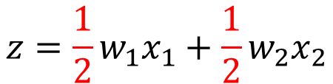
Testing of Dropout
x₁
x₂
x₁
x₂
x₁
x₂
w₁
w₂
w₁
w₂
w₁
w₂
z=w₁x₁+w₂x₂
z=w₁x₁+w₂x₂
z=w₂x₂
x₁
x₂
x₁
x₂
x₁
x₂
$$\frac{1}{2}$$
$$\frac{1}{2}$$
w₁
w₁
w₁
w₂
w₂
w₂
$$z=\frac{1}{2}w_{1}x_{1}+\frac{1}{2}w_{2}x_{2}$$
z=w₁x₁
z=0

Slide 30
Optimizing strategy
Activation function
Train error
Learning rate
Regularizer
Early stopping
Test error
Dropout

Slide 31
Do NNs need to be ‘deep’?
universal approximation theorem:
a feed-forward network with a single hidden layer containing a finite number of neurons (i.e., a multilayer perceptron), can approximate continuous functions on compact subsets of R^{n}, under mild assumptions on the activation function.

Slide 32
Do NNs need to be ‘deep’?
Check the keynote by Rich Caruana - Microsoft Research
Feature Transform!
Seide, Frank, Gang Li, and Dong Yu. "Conversational Speech Transcription Using Context-Dependent Deep Neural Networks." Interspeech. 2011.

Slide 33










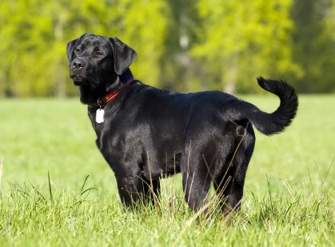
Do NNs need to be ‘deep’?
White cat
x100
x100
Black cat
x100
White dog
Black dog
x5

Slide 34
Do NNs need to be ‘deep’?
1ST try: simple multiple classifiers
White cat
IMAGE
WARNING
Black cat
White dog
Black dog

Slide 35
Do NNs need to be ‘deep’?
Add a feature transform
White cat
CAT OR DOG
IMAGE
Black cat
BLACK OR WHITE
White dog
Plenty of data!
Black dog

Slide 36

Questions?

